Slide 1
3 PHASE INDUCTION MOTOR
TOPIC :
Present By : Amit kumar

Slide 2
Contents :
Introduction
Important part of 3 phase induction motor
Working Principle of 3 phase induction motor
Equivalent circuit of 3 phase induction motor
Star Delta connection in 3 phase induction motor

Slide 3
Introduction :
The winding wound on the stator of three phase induction motor is also called field winding and when this winding is excited by three phase ac supply it produces a rotating magnetic.

Slide 4
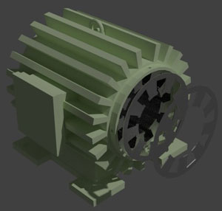
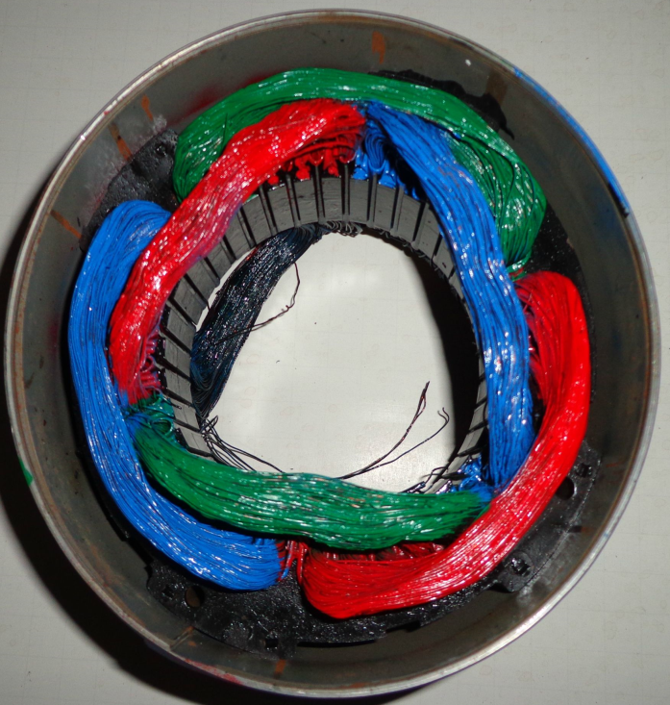
STATOR

Slide 5
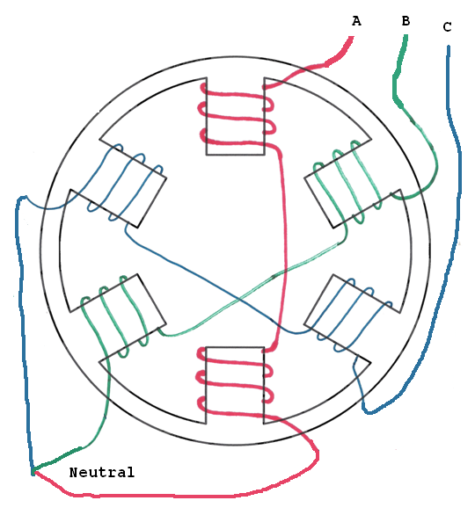
How to create the Pole in three phase induction motor?
2 Pole
4 Pole

Slide 6
What is the effect of pole in three phase induction motor?
N_{S} = 120f /P
Synchronous speed is inversely proportional to pole .
S= N_{S}-N_{r} /N_{s}
Where,
S= slip of motor
F= frequency of motor
P= pole of motor
N_{s}= Synchronous speed of motor
N_{r}= Synchronous speed of rotor

Slide 7
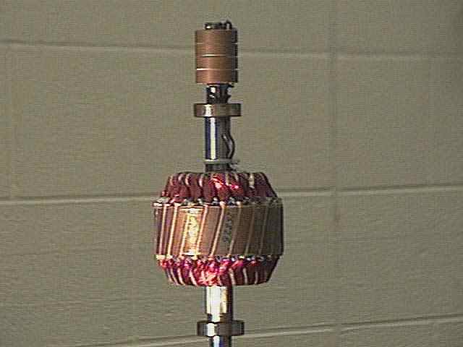
ROTOR
Rotor : Rotor is the rotating part of 3 phase induction motor .R o tor is a rotating part of induction motor .The rotor is connected to the mechanical load through the shaft .

Slide 8
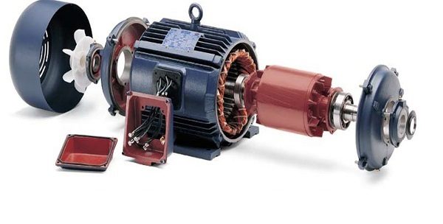
Working Principle of 3 phase induction motor

Slide 9
Why 3 phase induction motor are self started?

Slide 10
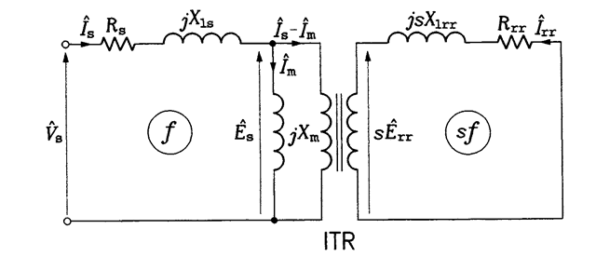
Equivalent Circuit of 3 phase induction motor
I₂
ROTOR

Slide 11
Why we need Star and Delta setup?
5A

Slide 12
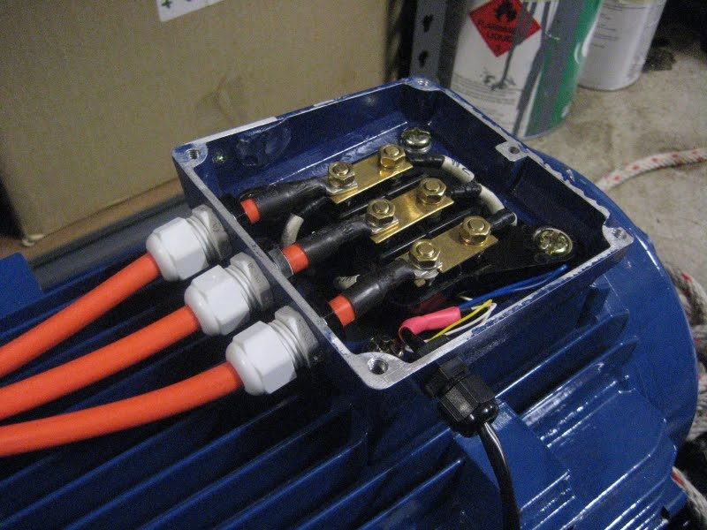
How to start motor without Star and Delta connection?
STAR CONNECTION
DELTA CONNECTION

Slide 13
Star and Delta connection

