Slide 1
ZEPTO – Zero Power Tuneable Optics:
Permanent Magnet Quadrupoles and Dipoles for CLIC
Jim Clarke
on behalf of Alex Bainbridge, Norbert Collomb, Ben Shepherd, (STFC Daresbury Laboratory) and Michele Modena (CERN)
10th Feb 2017, CLIC Implementation Meeting

Slide 2
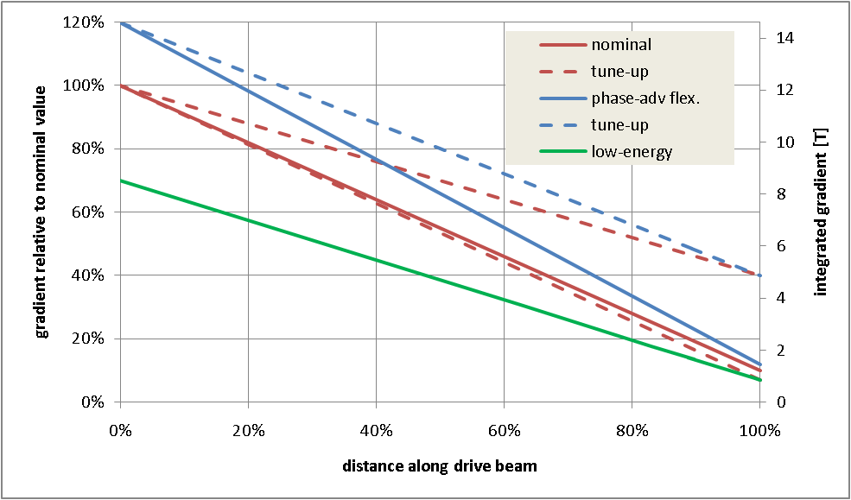
PM Quad Recap
We have developed PM alternatives for the Drive Beam Quads
  Two types were successfully prototyped to cover the full range required
Erik Adli & Daniel Siemaszko
Low Energy Quad
High Energy Quad
High energy quad – Gradient very high
Low energy quad – Very large dynamic range

Slide 3
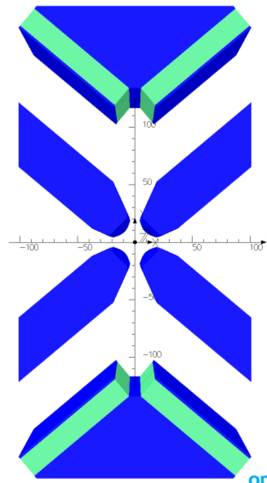
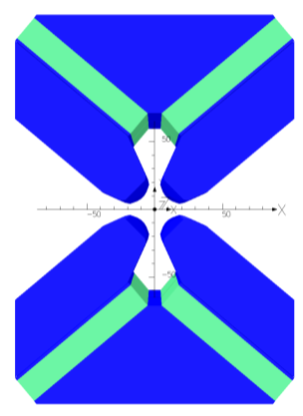
High Energy Quad Design
NdFeB magnets with B_{r} = 1.37 T (VACODYM 764 TP)
4 permanent magnet blocks each 18 x 100 x 230 mm
Mounted at optimum angle of 40°
Max gradient = 60.4 T/m (stroke = 0 mm)
Min gradient = 15.0 T/m (stroke = 64 mm)
Pole gap = 27.2 mm
Field quality = ±0.1% over 23 mm
Stroke = 64 mm
Poles are permanently fixed in place.
Stroke = 0 mm

Slide 4
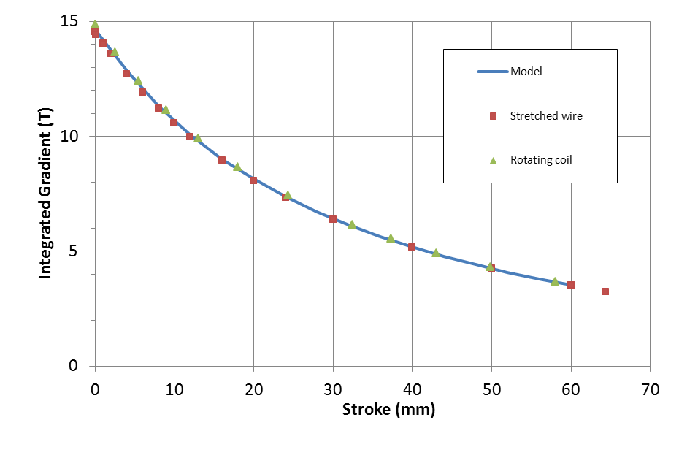
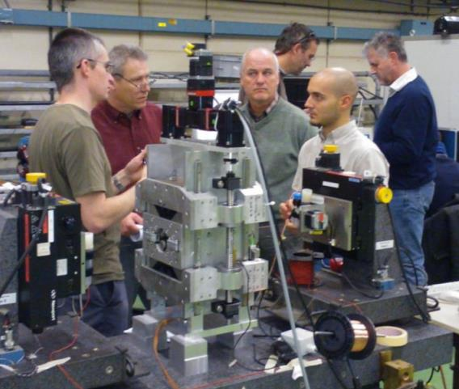
High Energy Quad
Measured Integrated Gradient
Gradient, Integrated Gradient, and Field Quality all good.
Main issue: Magnet centre moves with motion of PMs

Slide 5
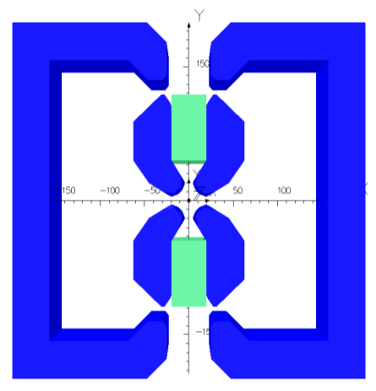
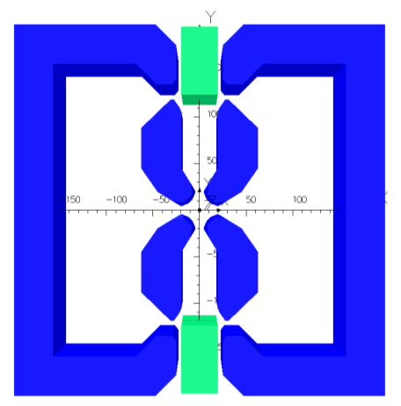
Low Energy Quad Design
Lower strength easier but requires much larger tunability range (x12)
Outer shell short circuits magnetic flux to reduce quad strength rapidly
NdFeB magnets with B_{r} = 1.37 T (VACODYM 764 TP)
2 permanent magnet blocks are 37.2 x 70 x 190 mm
Max gradient = 43.4 T/m (stroke = 0 mm)
Min gradient = 3.5 T/m (stroke = 75 mm)
Pole gap = 27.6 mm
Field quality = ±0.1% over 23 mm
Stroke = 75 mm
Poles and outer shell are permanently fixed in place.
Stroke = 0 mm

Slide 6
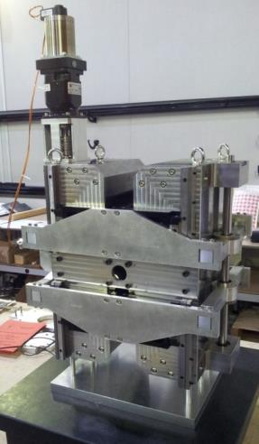
Low Energy Quad
Measured Integrated Gradient
Maximum gradient: 45.0 T/m
Minimum gradient: 3.6 T/m
Gradient, Integrated Gradient, and Field Quality all good.
Main issue: Magnet centre moves with motion of PMs

Slide 7
CLIC PM Dipoles
Next we have investigated PM dipoles
  Drive Beam Turn Around Loop (DB TAL)
  Main Beam Ring to Main Linac (MB RTML)
Total power consumed by both types: 15 MW
Several possible designs considered for DB TAL (the most challenging of the two test cases)
Type | Quantity | Length (m) | Strength (T) | Pole Gap (mm) | Good Field Region (mm) | Field Quality | Range (%)
MB RTML | 666 | 2.0 | 0.5 | 30 | 20 x 20 | 1 x 10⁻⁴ | ± 10
DB TAL | 576 | 1.5 | 1.6 | 53 | 40 x 40 | 1 x 10⁻⁴ | 50–100

Slide 8
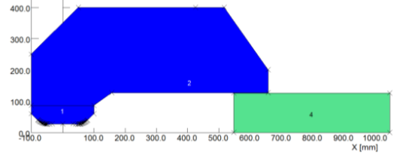
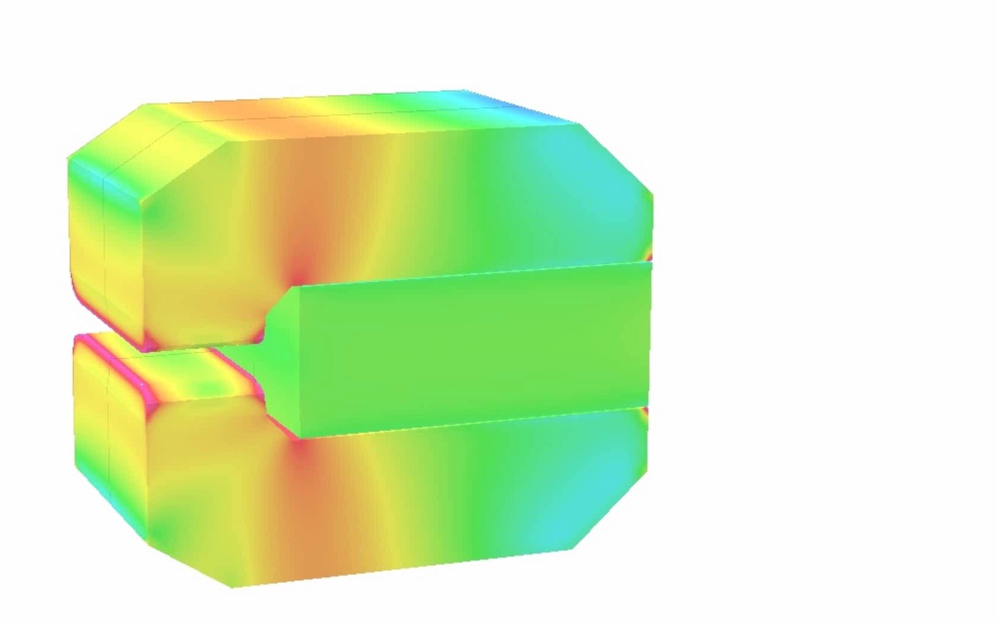
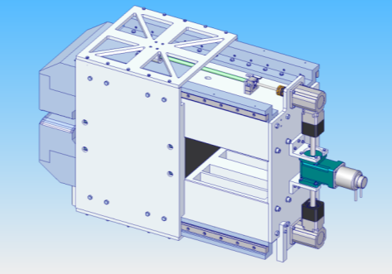
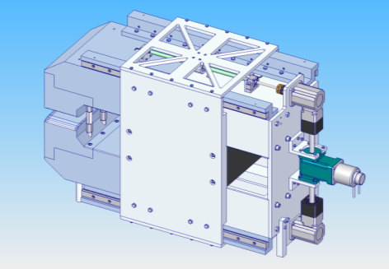
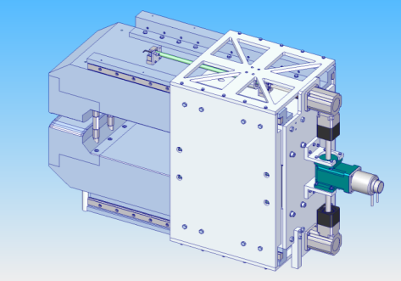
Selected Dipole Design
  Sliding PM in backleg
  Similar to low energy DBQ
  Rectangular PM
  Forces manageable
  C – shape possible
  Curved poles (along beam arc) possible
  Wide
  Large stroke
Sliding assembly using rails, stepper motor and a gearbox.
This should cope with the horizontal forces (27kN peak) and hold the Magnet steady at any point on a 400 mm stroke.

Slide 9
Dipole Prototype
Original plan was to build a 0.5m version of full size DB TAL magnet
However, cost exceeded available budget
So, instead we are building a scaled version
  Cost dominated by one off PM block costs (>50%)
  Will still demonstrate the tuneable PM dipole principle as well as achieving the same field quality and have the same relative tuning range.
Type | Length (m) | Max Field Strength (T) | Pole Gap (mm) | Good Field Region (mm) | Field Quality | Range (%)
DB TAL | 1.5 | 1.6 | 53 | 40 x 40 | 1 x 10⁻⁴ | 50–100
Original Prototype | 0.5 | 1.6 | 53 | 40 x 40 | 1 x 10⁻⁴ | 50–100
Scaled Prototype | 0.4 | 1.1 | 40 | 30 x 30 | 1 x 10⁻⁴ | 50–100
Note: Scaled Prototype weighs ~1500kg ! PM block is ~350kg!

Slide 10
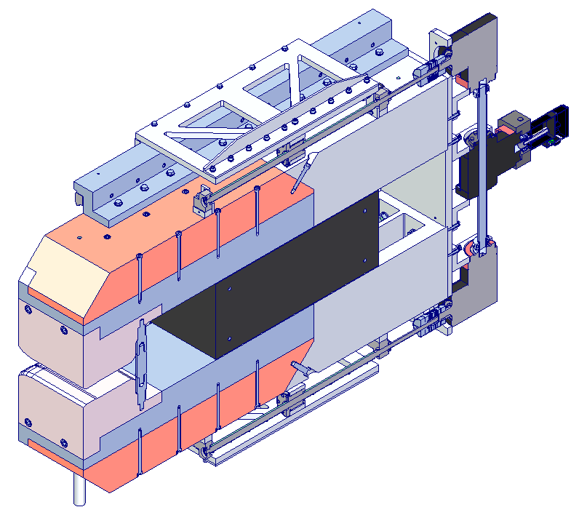
Prototype Dipole Overview
“T-gearbox”
Sideplate & Nut Plate Assembly
Motor
Section View
Right angle - gearbox
Principle:
The motor drives the ballscrews through a “T-gearbox” and “right angle gearbox”.
This moves the ballscrew nut which is connected via the housing to the Nut Plate Assembly.
This in turn moves the permanent magnet via the PM side-plates.
Permanent Magnet
Ballscrew Nut

Slide 11
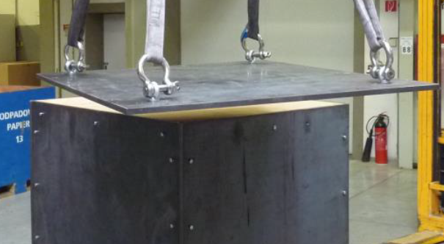
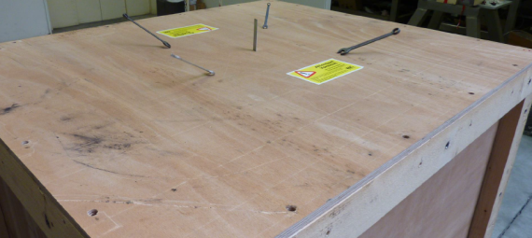
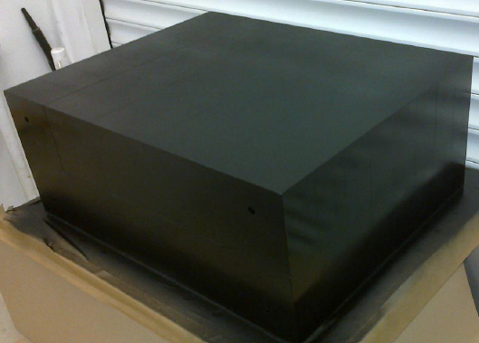
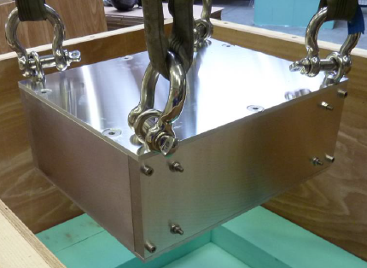
PM Block Details
Manufactured, measured & delivered by Vacuumschmelze
Magnet block dimensions are 500x400x200 mm, with 4 holes on 400mm axis for mounting tie rods.
Magnet material NdFeB, Vacodym 745TP (Br 1.38T)
Constructed from 80 (large!) individual blocks glued together (each 100x50x100mm)
World’s largest ever NdFeB PM block?

Slide 12
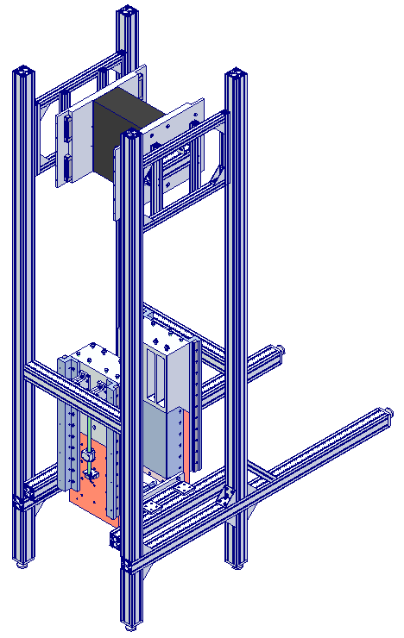
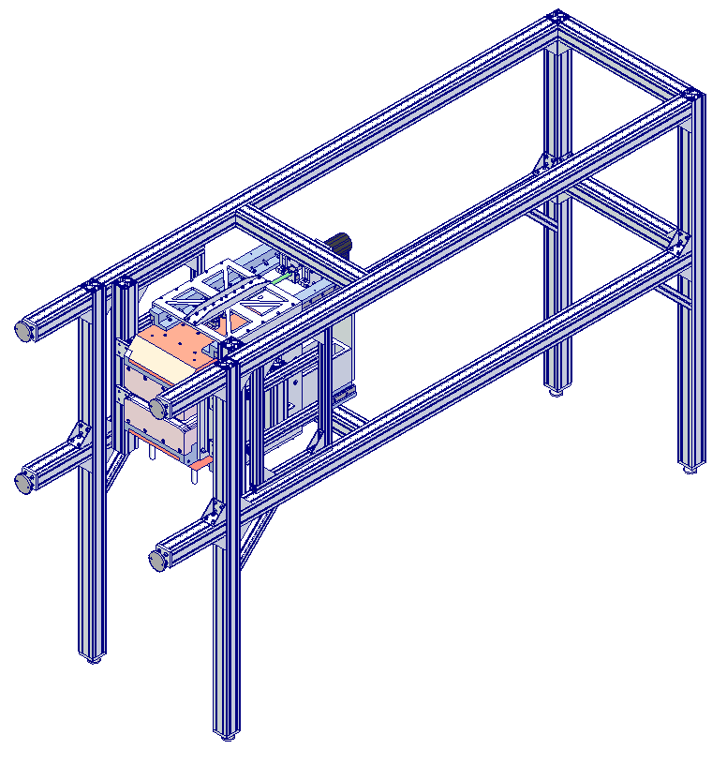
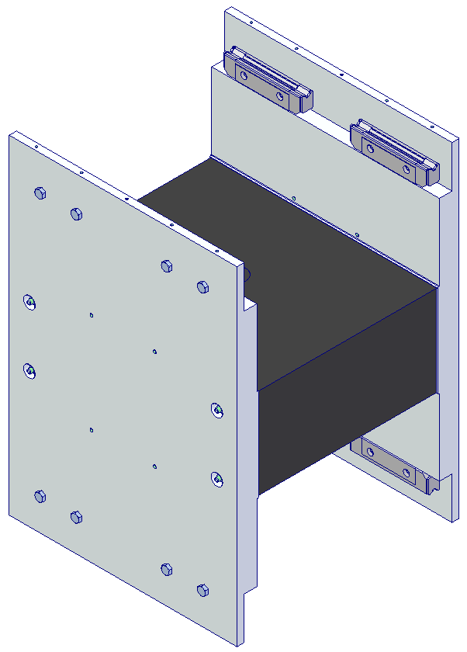
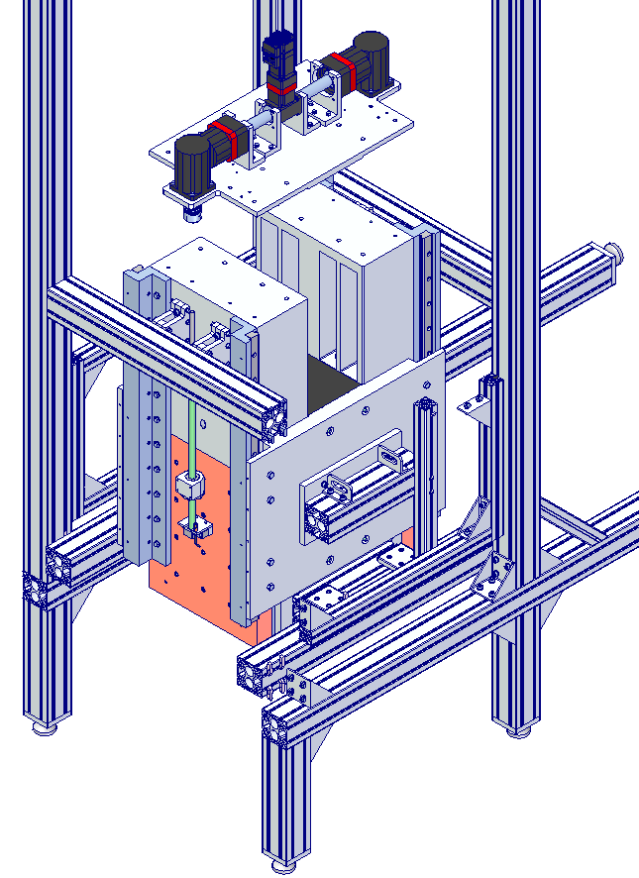
Prototype Progress
All externally procured items have been delivered
Assembly area prepared (non-trivial) – specific safety training has been given to all staff involved
Assembly anticipated to be complete by early March 2017
Measurements (at DL only) and Report to follow immediately afterwards
Assembly Sequence

Slide 13
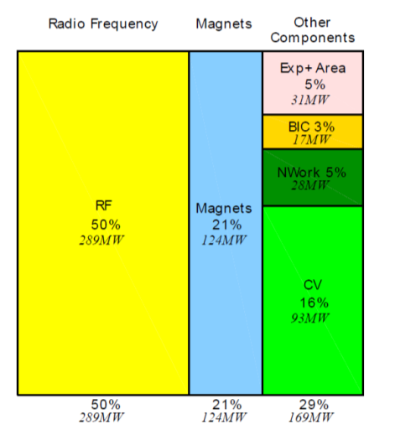
Next Steps
Work with CLIC beam dynamics team to maximise benefit of PM magnets – starting today!
Assess which other magnet families within 380GeV CLIC could be PM based to reduce the overall cost and power demand
Optimise current quad designs to minimise capital cost
Power consumption by technical systems for CLIC 3 TeV

Slide 14
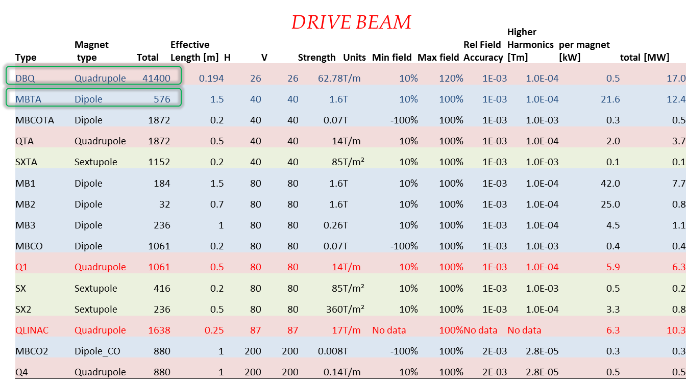
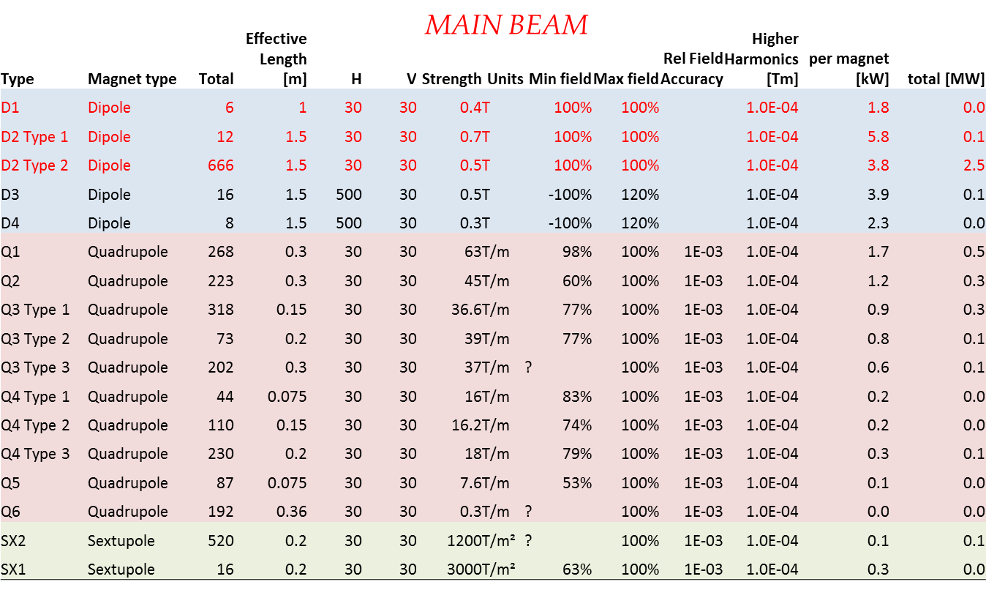
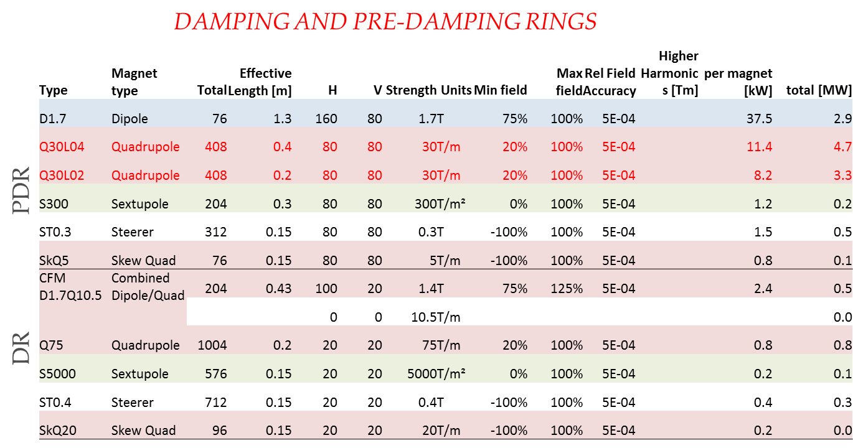
Quick Assessment May 2016
Several promising candidates rapidly identified (another 28MW)

Slide 15
Example Cost Reduction
Erik Adli & Daniel Siemaszko
60mm stroke
Wide tuneability is expensive – better to limit tuneability

Slide 16
Example Cost Reduction
25mm stroke
Erik Adli & Daniel Siemaszko
Reduced range of motion will help significantly – magnets can be modular – same intrinsic design but with different PM block sizes for example.

Slide 17
Example Cost Reduction
8mm stroke
Erik Adli & Daniel Siemaszko
Restricting the beam requirements will have a big impact

Slide 18
Quad Comments
Quad procurement cost reduction drivers
  Simplification of design
  “Modular” solutions
  Reduced tuning ranges (motion requirements) – e.g. ~8 to 100% has been demonstrated but ~80 to ~100% will allow simpler & cheaper motion system
  Reduced PM material volumes or cheaper material
  More relaxed space constraints
  Reduced magnet aperture, gradient, magnetic length
PM Quads are generally applicable across CLIC and minimising the requested tuning range will help significantly!

Slide 19
Dipole Comments
Dipole procurement cost reduction drivers
  Simplification of design, reduction in forces
  Reduced tuning ranges (motion requirements) – e.g. ~50 to 100% looks just about feasible but ~90 to 100% will be much simpler, cheaper, and more practical to implement
  Reduced PM material volumes or cheaper materials
  Reduced magnet aperture, field, magnetic length
PM Dipoles are much less applicable generally, fixed field straightforward, even modest tuneability (e.g. ~90 to 100% ) is difficult.
Long (e.g. 2m) versions would priobably have to be multiple short versions.
Possible “Hybrid” solution?
  Combination of fixed field PM & tuneable EM dipoles?
PM
EM
PM

